Slide 1
Creating and Using Your FSA ID: An Overview
[Lori Auxier] | [November 2016]
Notes:
Note to Presenter: This presentation provides information on the FSA ID that can be used in outreach to students and parents. The presentation was created by Federal Student Aid, an office the U.S. Department of Education. You may add or delete content to/from it. However, you must ensure that any edits made to this presentation and/or any uses of this presentation are done in a manner that furthers the goals of the Department. [This presentation was produced in November 2015.]

Slide 2
Topics Covered
What is the FSA ID?
Do my parents need an FSA ID?
How do I create an FSA ID?
Where can I use my FSA ID?
What to Do
I Forgot My Username or Password
I’m Locked Out of My Account
Where can I get more information?
2

Slide 3
What is the FSA ID?
The FSA ID is a username and password used by students, parents, and borrowers to:
login to U.S. Department of Education websites
electronically sign documents
You will use it:
Every year you apply for federal student aid at fafsa.gov
To receive a federal student loan
To perform important activities as a federal student loan borrower, such as choosing a repayment plan or applying for a deferment
3

Slide 4
Does my parent need an FSA ID?
If you are a dependent student, then your parent will need an FSA ID in order to sign your FAFSA electronically
Not sure if you’re considered a dependent student for the FAFSA, go to StudentAid.gov/dependency to find out
IMPORTANT
You and your parent must have different FSA IDs
You must create your own FSA ID—it’s your electronic signature and you need to own it
Your parent must create his or her own FSA ID
You and your parent should each use your own e-mail address when creating an FSA ID (you can’t use/share the same e-mail address)
4

Slide 5
How do I create an FSA ID?
5

Slide 6
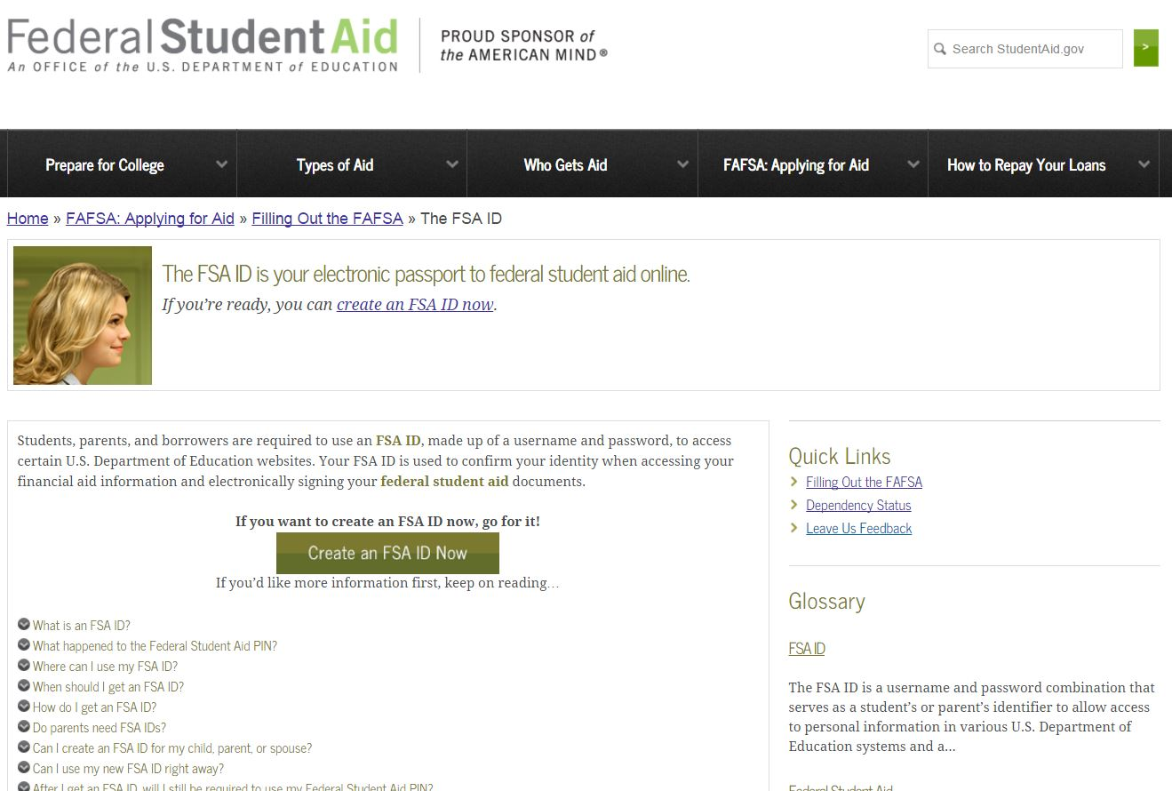
Getting Started
Go to StudentAid.gov/fsaid
Click the “Create an FSA ID Now” button
6

Slide 7
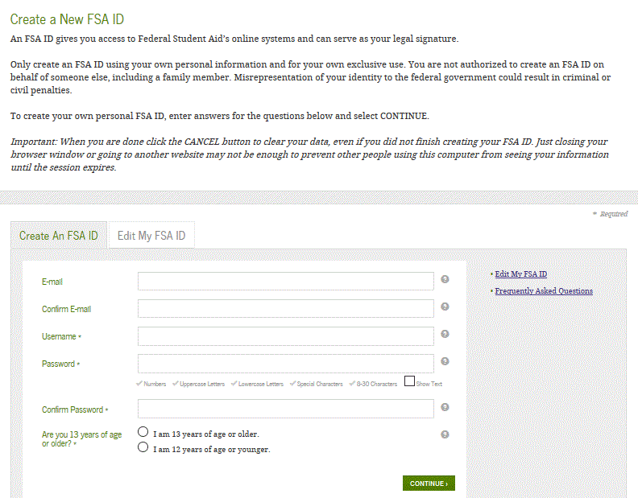
Create Your FSA ID (Username and password)
E-mail:
Optional but strongly recommended
Each FSA ID must have a unique e-mail address (you and your parent cannot use the same e-mail address)
You must have access to this e-mail account
Username:
Don’t include personal info such as date of birth or name
If you see a message “Username taken, create a different username” then someone has already used that username
You can select “Show Text” to see what you’re typing
7

Slide 8
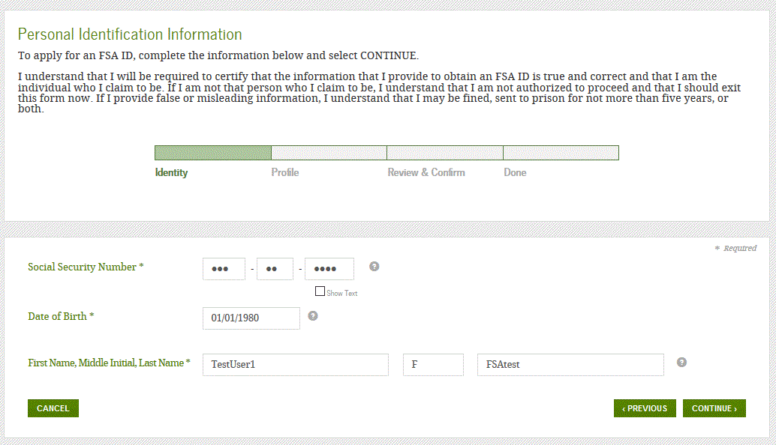
Provide Personal Information
Make sure your Social Security number, date of birth, and name match what’s on your Social Security card
You must have a Social Security number to create an FSA ID.
8
Notes:
On the next screen, you’ll be asked to provide your personal information. Make sure your Social Security number, date of birth, and name match what’s on your Social Security card.

Slide 9
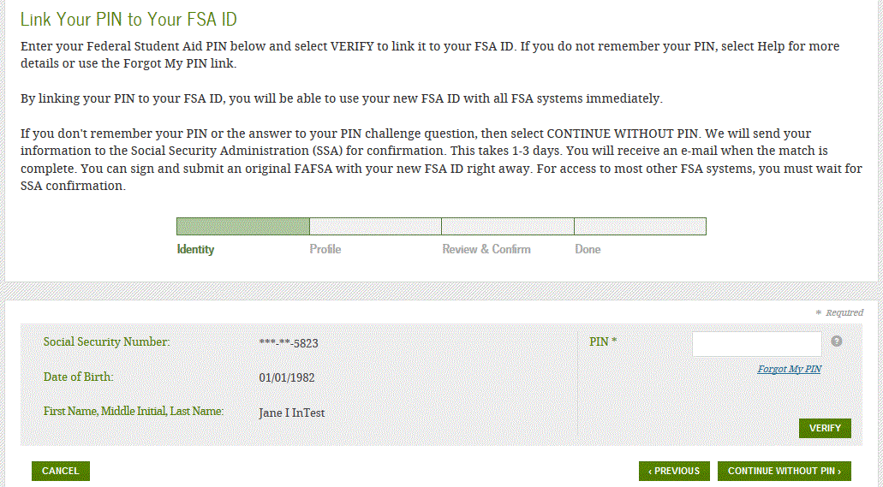
Link Your PIN (if you have one)
If you applied for federal student aid before May 2015, then you most likely had a 4-digit PIN—the FSA ID replaces the PIN; you can link your PIN to your FSA ID on this screen
If you can’t remember your PIN, you can select “Forgot My PIN” and answer a challenge question or you can continue without linking your PIN
If you didn’t have a PIN, then you won’t see this screen
9
Notes:
Note to presenter: If a student doesn’t have a PIN or doesn’t link his or her PIN to the FSA ID, the student can still create his or her FSA ID.
The student will be able to use his or her FSA ID to sign and submit a new (original) FAFSA right away.
The student will need to wait 1-3 days for the Social Security Administration to confirm his or her information before the student can take certain other actions, such as submitting a renewal FAFSA

Slide 10
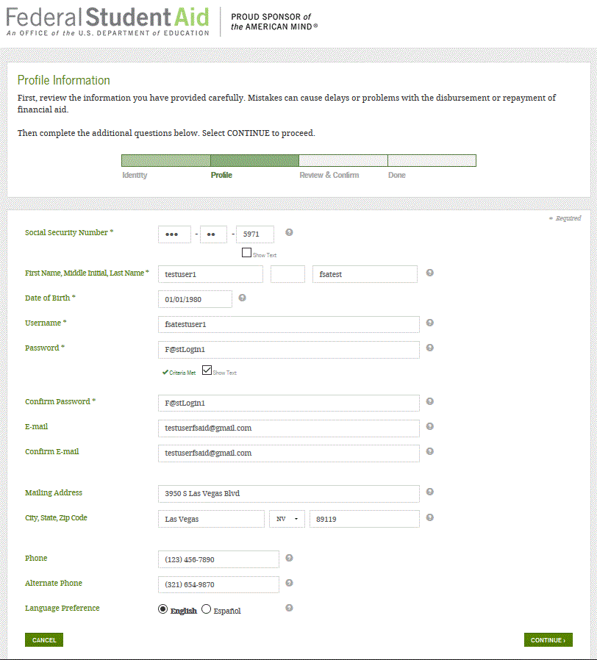
Provide Profile Information
Confirm information you entered previously and provide additional information
Make sure your information is correct; any errors could result in a delay or problem in your receiving financial aid (or the repayment of your federal student loans)
10

Slide 11
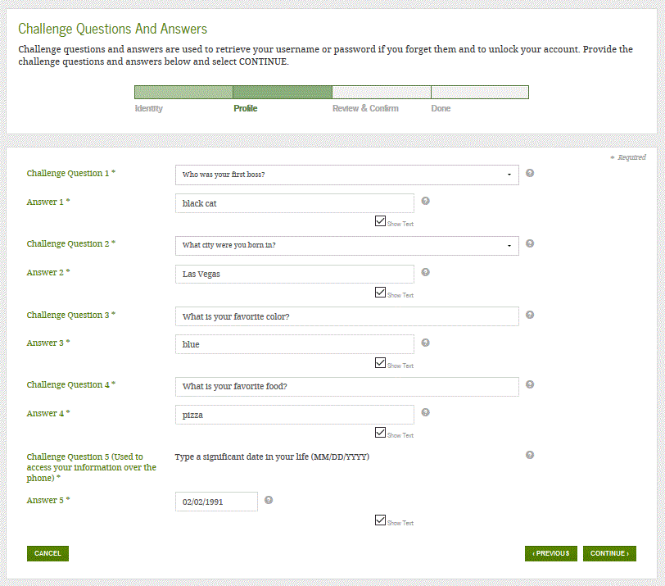
Select/Create Challenge Questions and Answers
Answering your challenge questions is one way to unlock your account or reset your username and password
Questions 1 and 2:
Select a question from the dropdown menu and then enter your answer
Questions 3 and 4:
Make up your own question and enter your answer
Make sure the answers will be easy to remember
Examples of questions:
What’s your favorite color?
What’s your favorite food?
Question 5:
Enter a significant date
It can’t be your date of birth
Examples of dates:
Favorite holiday
Sibling or parent date of birth
You can select “Show Text” to see what you’re typing
11
Notes:
Note to presenter: Challenge Question 5 (significant date) is only used by a student to access his or her loan history through automated phone systems, such as the Federal Student Aid Information Center.

Slide 12
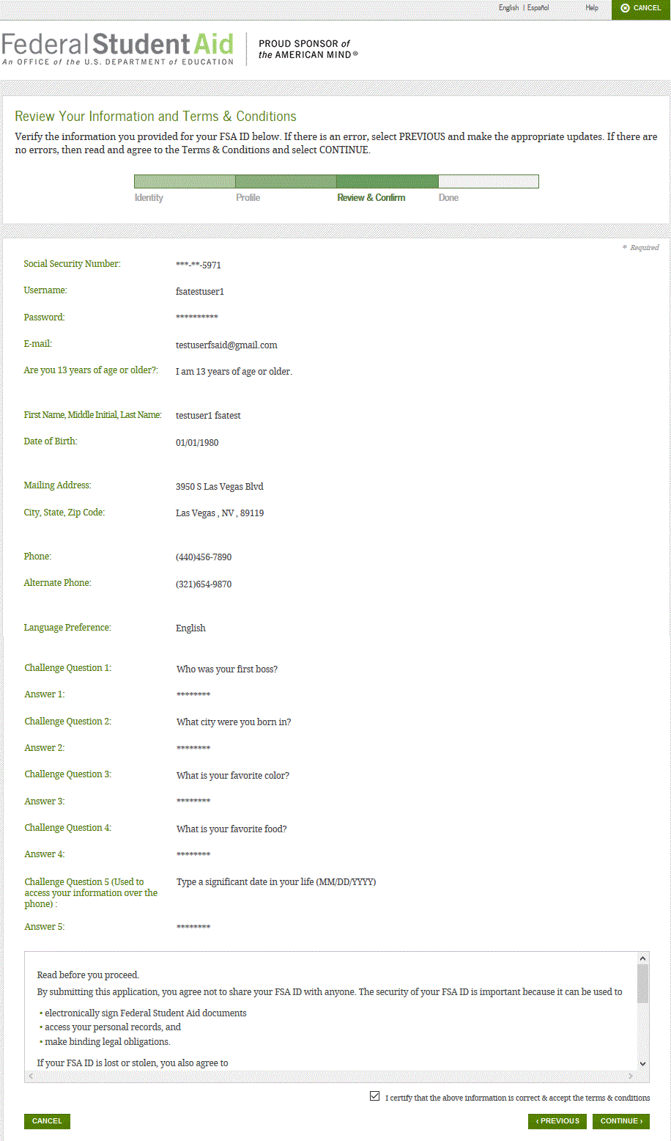
Review Info and Agree to Terms
Review and confirm your information
If you need to make a correction, use the “Previous” button
Review and agree to the terms and conditions for using your FSA ID
12

Slide 13
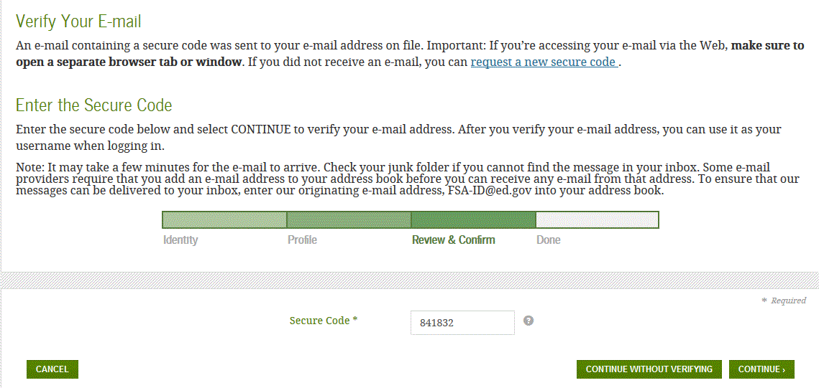
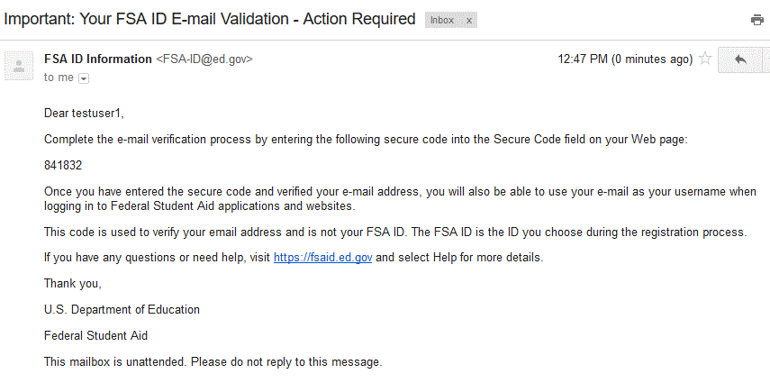
Verify Your E-mail
E-mail Verification Page
If you provided an e-mail address, then you will be taken to the E-mail Verification page
Once you verify your e-mail, you can use your e-mail address as your username when logging in to Department of Education websites
You can also continue without verifying
How to Verify Your E-mail
Do not close the E-mail Verification page
We’ll send you an e-mail with a secure code
Log in to your e-mail account using a different tab or browser window or another device
Look for an e-mail with the subject line, “Important: Your FSA ID E-mail Validation - Action Required”
The e-mail will include a six-digit, numeric code that you will enter in the “Secure Code” data field
E-mail With Your Secure Code
13

Slide 14
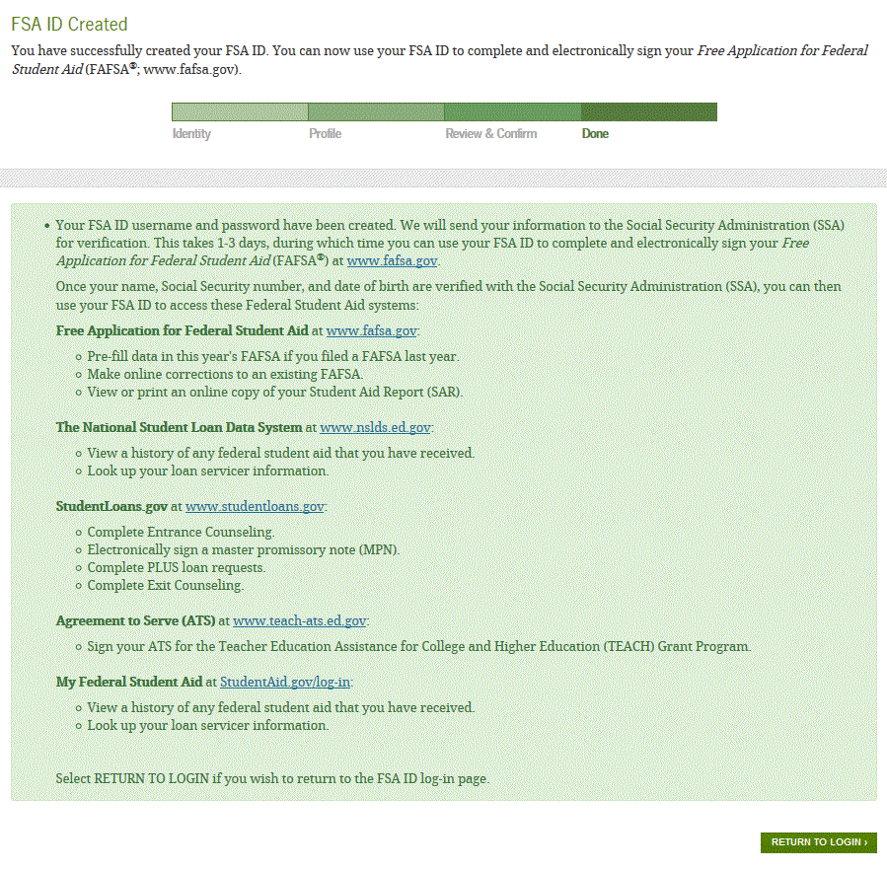
Your FSA ID is created!
Your FSA ID was created
If you provided an e-mail address, then you will receive a confirmation e-mail
Using Your FSA ID
You can log in to fafsa.gov and complete, sign, and submit a new (original) FAFSA
If you didn’t provide or link to a PIN, then your info will be sent to the Social Security Administration for confirmation
SSA review will take 1-3 days
Until your info is verified, you won’t be able to take certain actions, such as correct your FAFSA, submit a renewal FAFSA, or sign a Master Promissory Note.
14

Slide 15
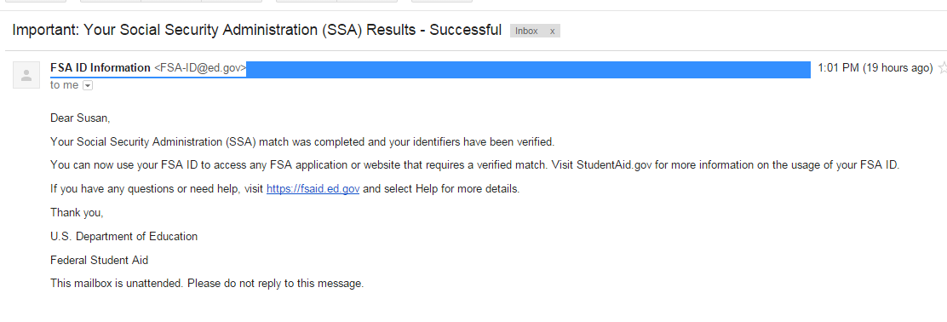
Social Security Administration Matching
You should receive an e-mail informing you of the results of the SSA review; If you did not provide an e-mail when creating your FSA ID, you can check the status by logging in at FSAID.ed.gov using the “Edit My FSA ID” tab
If there is an issue, log in at FSAID.ed.gov using the “Edit My FSA ID” tab and review/update your profile info; If your info is correct, you’ll need to contact the SSA (to find your local SSA office, call 1-800-772-1213 or go to www.ssa.gov)
15

Slide 16
Where can I use my FSA ID?
16

Slide 17
Using Your FSA ID
Website | What You Can Do at the Site
fafsa.gov | Electronically sign your (or your child's) FAFSA Import your tax information from the Internal Revenue Service Prefill data in this year´s FAFSA if you filed a FAFSA last year (Renewal FAFSA) Make online corrections to an existing FAFSA View or print an online copy of your Student Aid Report (SAR)
My Federal Student Aid at StudentAid.gov/login or the National Student Loan Data System (NSLDS®) at www.nslds.ed.gov | View a history of any federal student aid that you have received Look up your loan servicer's contact information
StudentLoans.gov | Complete entrance counseling, the Financial Awareness Counseling Tool, or exit counseling Electronically sign a master promissory note (MPN). Complete PLUS loan requests Estimate your student loan payments using the Repayment Estimator Apply for an income-driven repayment plan or a consolidation loan
Agreement to Serve (ATS) at www.teach-ats.ed.gov | Sign your ATS for the Teacher Education Assistance for College and Higher Education (TEACH) Grant Program
17

Slide 18
What to Do:
I Forgot My Username or Password
18

Slide 19
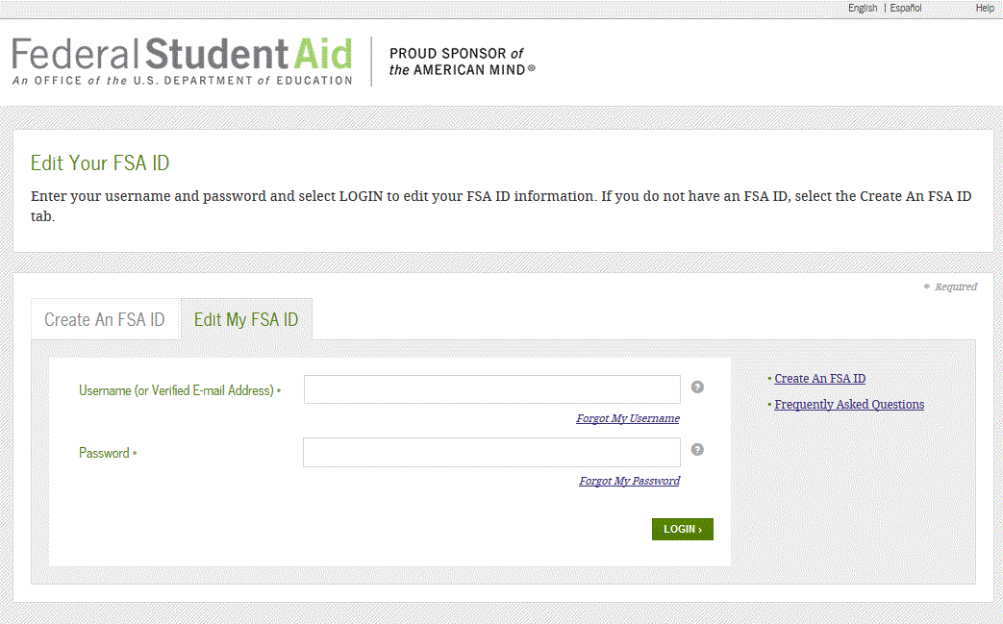
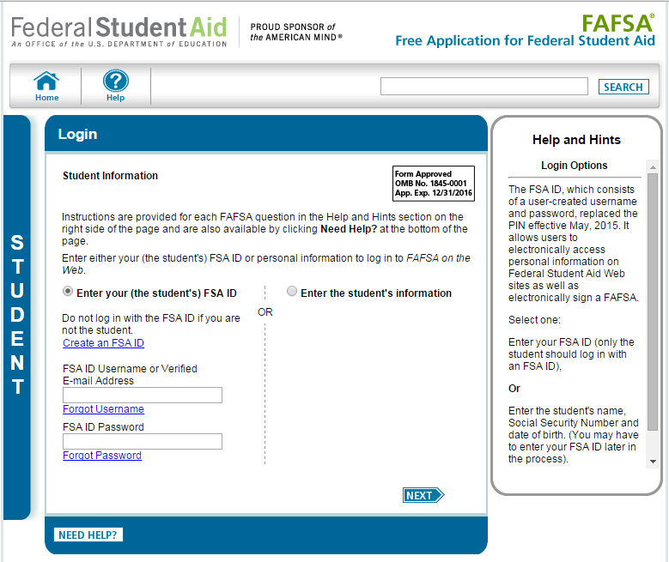
Forgot My Username
Select “Forgot My Username” at the Log In Screen
The appearance of the link may vary depending on what website you are visiting
Edit My FSA ID Screen
19
FAFSA Log In Screen

Slide 20
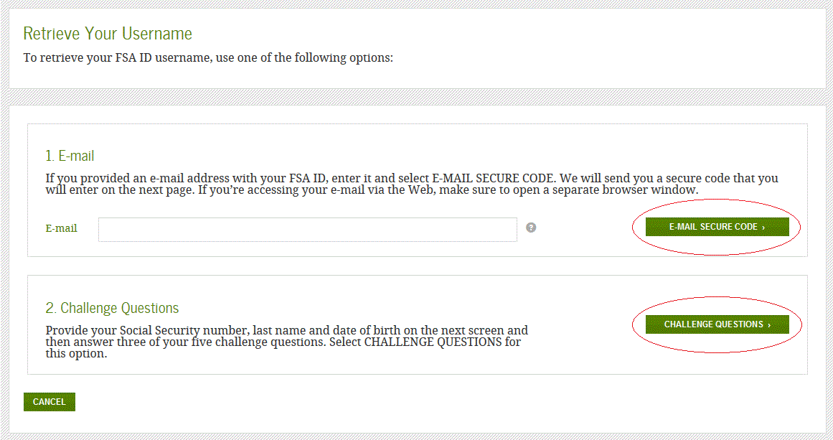
Forgot My Username
You can retrieve your username by either:
Having a secure code e-mailed to you (enter the e-mail address associated with your FSA ID account and click the “E-mail Secure Code” button)
Providing personal information and answering your challenge questions (click the “Challenge Questions” button)
20

Slide 21
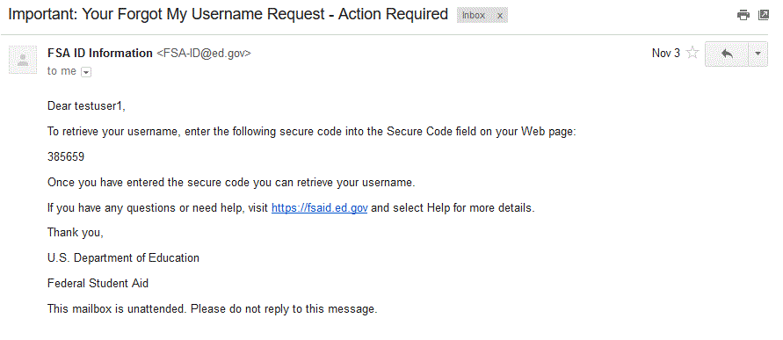
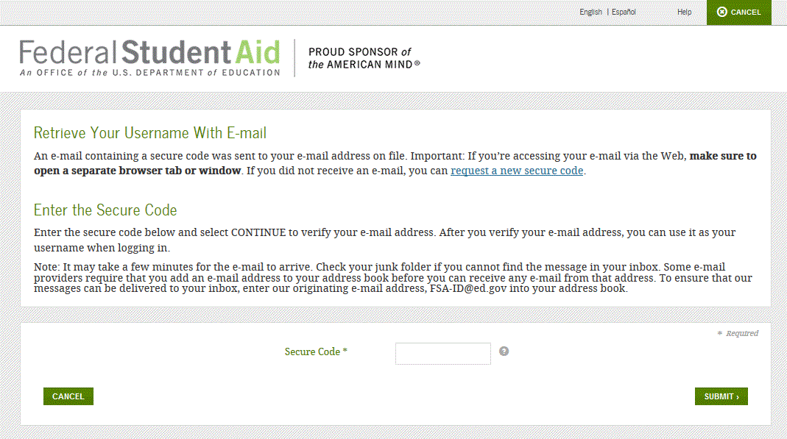
Retrieving Username Using Secure Code
If you selected “E-mail Secure Code,” an e-mail will be sent to your e-mail account and you will be taken to a page where you can enter a secure code
Do not close this page!
Open your e-mail in a new browser window or tab or different device and copy the code from your e-mail and enter it into the “Secure Code” box
E-mail With Your Secure Code
21

Slide 22
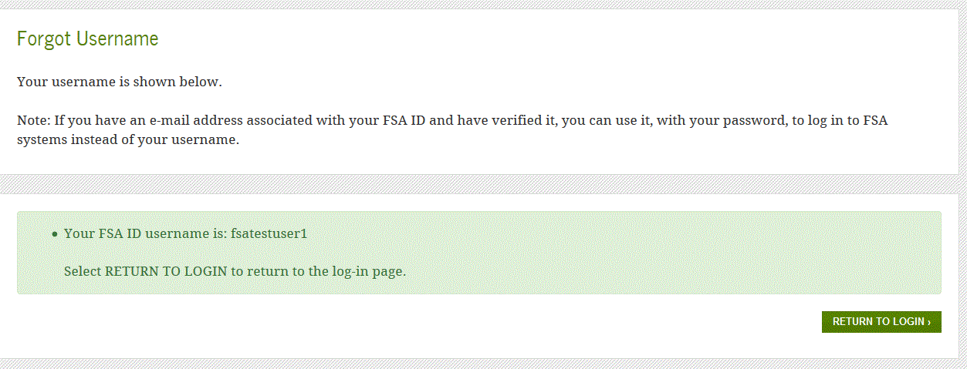
Retrieving Username Using Secure Code
Once you enter the secure code the screen will display your username
22

Slide 23
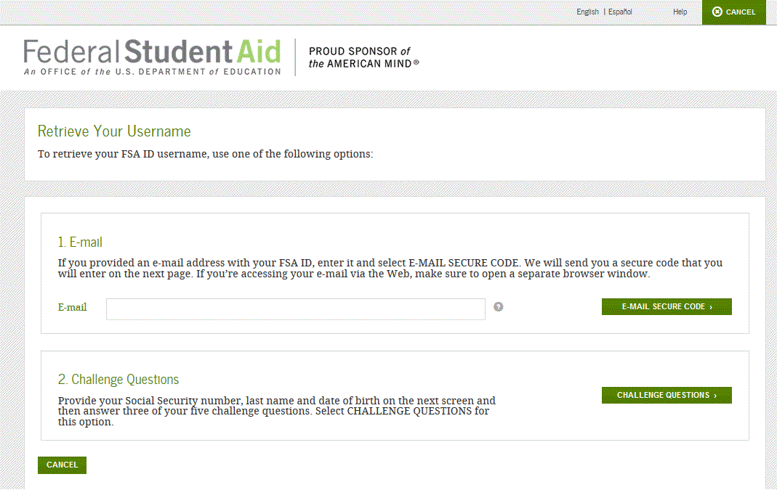
Forgot My Username
If you prefer to retrieve your username by answering your challenge questions, click the “Challenge Questions” button
23

Slide 24
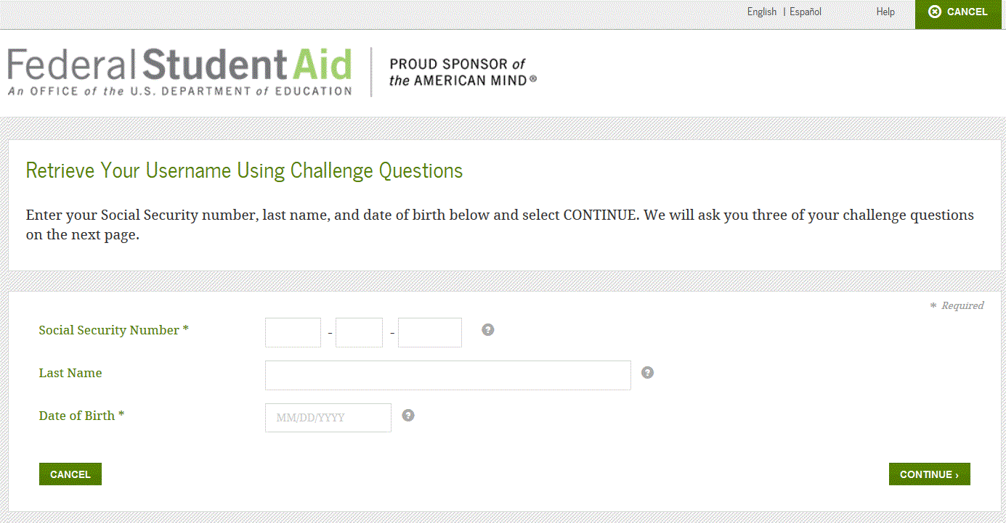
Retrieving Username Using Challenge Questions
If you selected “Challenge Questions,” you will be taken to a screen where you need to enter your Social Security number, last name, and date of birth
24

Slide 25
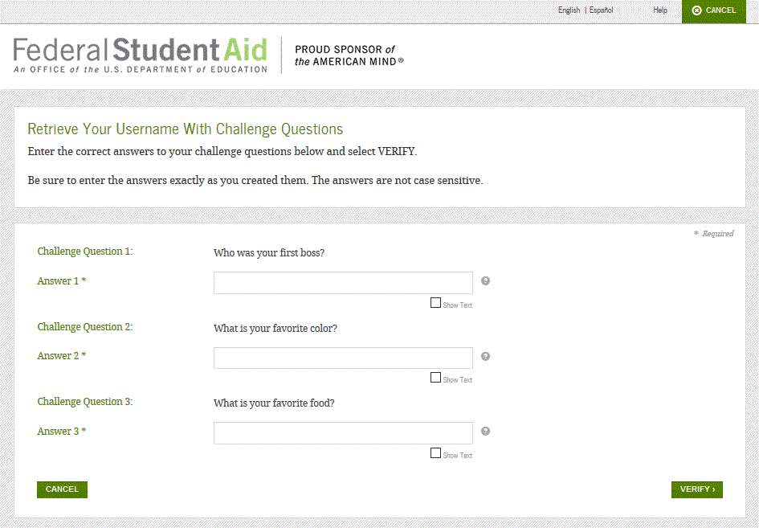
Retrieving Username Using Challenge Questions
You will be taken to a page where you will need to answer three of your challenge questions
After answering the challenge questions, you will be taken to page that displays your username
IMPORTANT
If you retrieve your username using the challenge questions, you will need to wait 30 minutes before you can use your username
25

Slide 26
What to Do:
I’m Locked Out of My Account
26

Slide 27
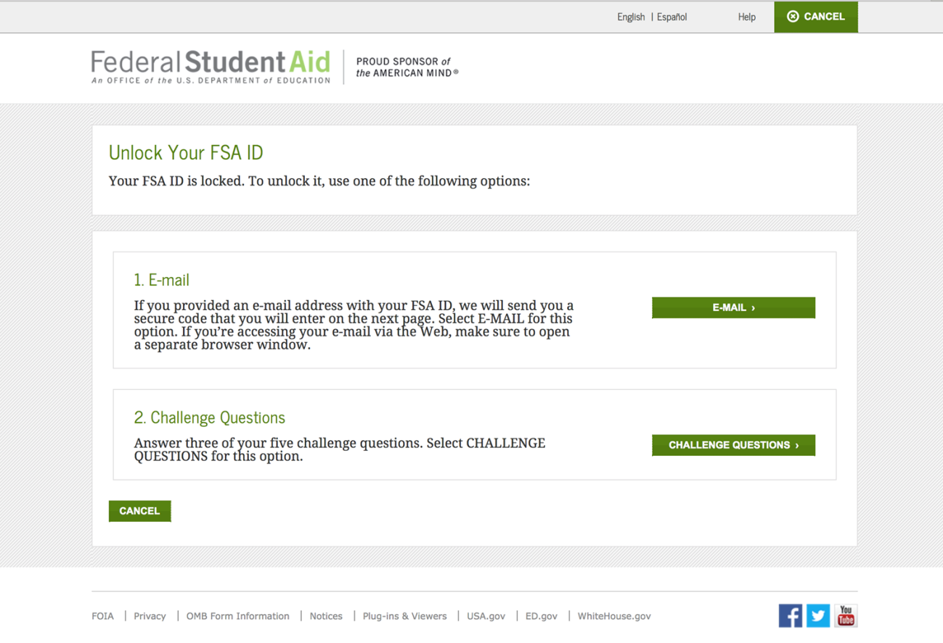
Locked Out
If you’ve been locked out of your FSA ID account for providing the wrong username or password, you can unlock your account using either e-mail or the challenge questions
27

Slide 28
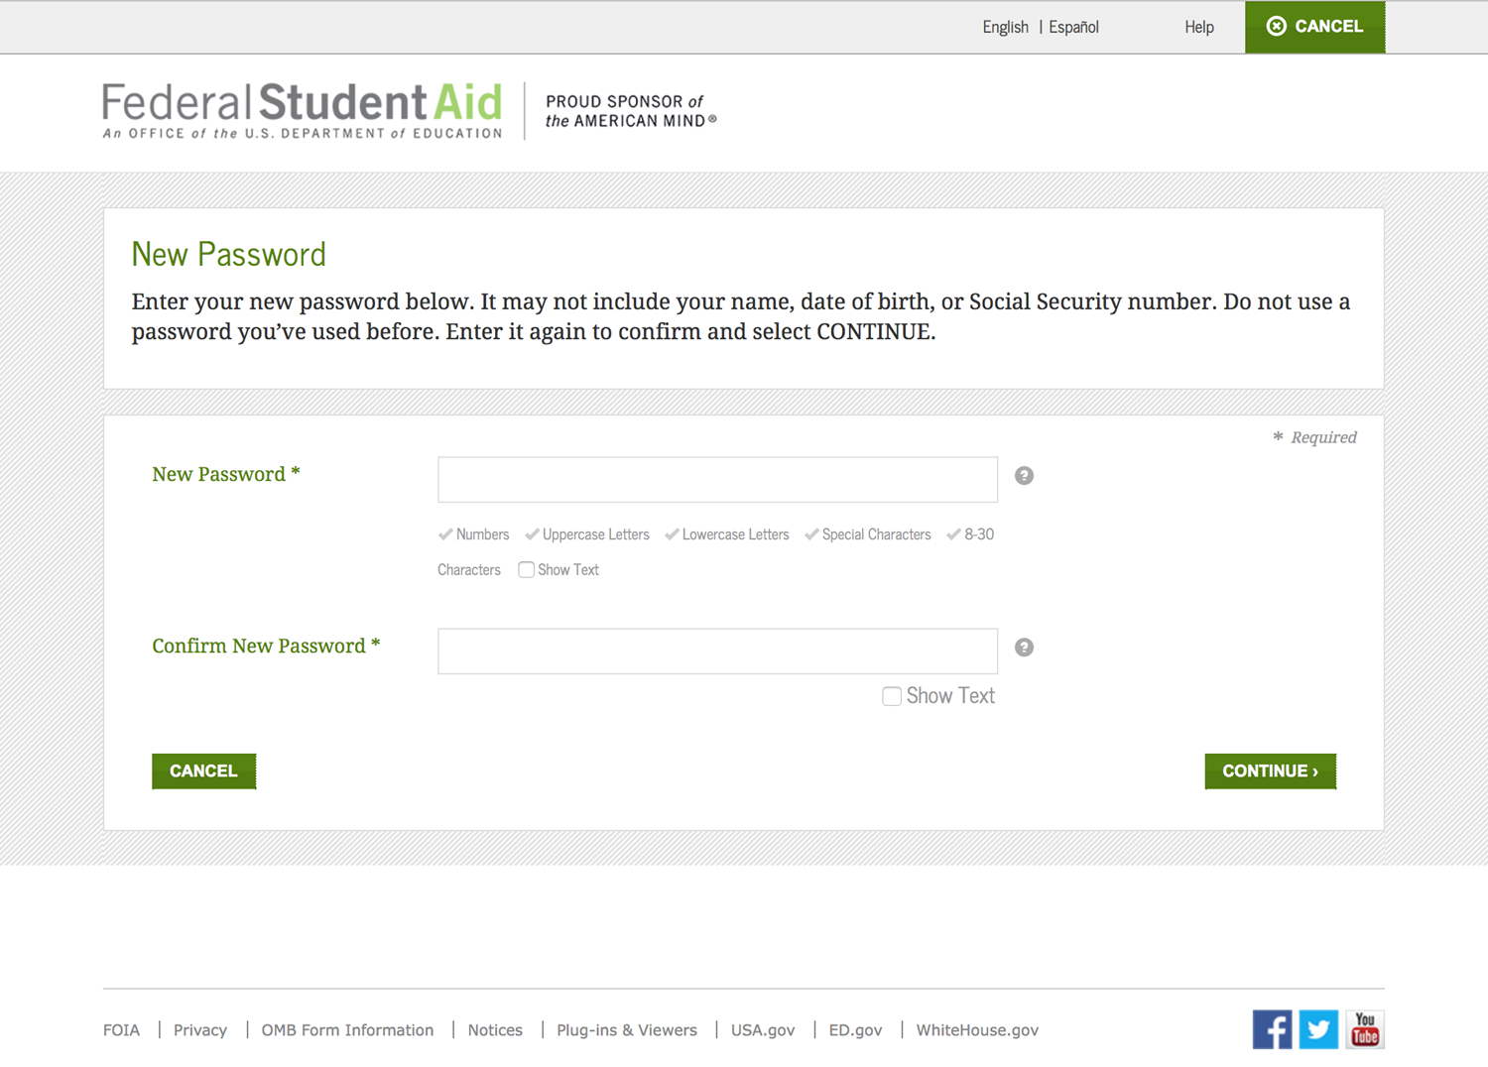
Locked Out
Once you successfully enter the secure code or answer your challenge questions, you will be taken to this screen to change your password
28

Slide 29
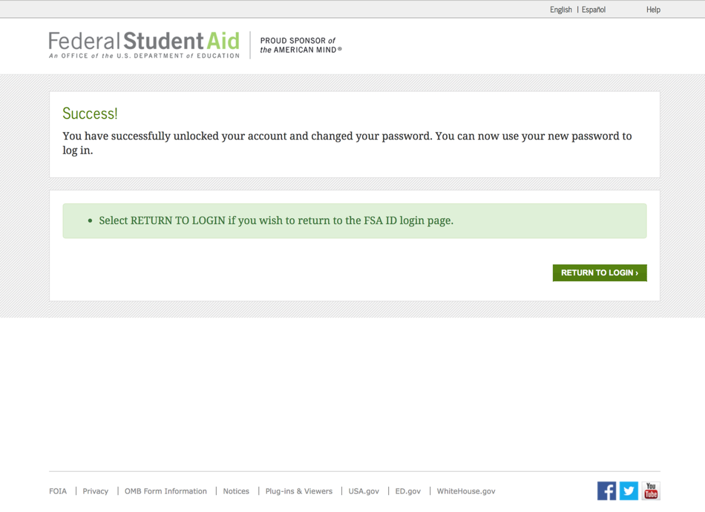
Locked Out
Once you enter a new password and re-enter it successfully, you receive the following message
29

Slide 30
Where can I get more information?
30

Slide 31
Where can I get more information?
Additional details on the FSA ID including answers to frequently asked questions and tips on creating an FSA ID, can be found at StudentAid.gov/fsaid
31

