Slide 1
Financial Aid Overview
Presented by the
Office of Student Financial Assistance (OSFA)

Slide 2
Financial Aid Overview
2024-25 High School Student Graduates
Enrolling/Appling for the
2025-26 Academic Year

Slide 3
Financial Aid has its own language and acronyms:
COA - Cost of Attendance
CSS Profile - College Scholarship Service Profile
FAFSA - Free Application for Federal Student Aid
FSA ID - Federal Student Aid Identification
FSS - FAFSA Submission Summary
SAI - Student Aid Index
FFAA - Florida Financial Aid Application
ED/FSA - U.S. Department of Education/Federal Student Aid
FLDOE/OSFA - Florida Department of Education/Office of Student Financial Assistance

Slide 4
Agenda
What is Financial Aid?
Where do I Find Financial Aid?
How and When Do I Apply?
Who Can Help me?

Slide 5
What is Financial Aid?
Monies received from four sources:
Federal
State
Institutional
Private
May also be categorized as:
Gift Aid
Self Help
Need-based
Merit-based
Can cover direct or indirect costs

Slide 6
What is Financial Aid?
Monies received from four sources:
Federal Aid:
Pell Grant (Gift Aid) (Need-based)
FSEOG (Gift Aid) (Need-based)
Work Study (Self-Help)
Federal Student Loans (Self-Help)
Student (Subsidized/Unsubsidized)
Parent Loans

Slide 7
What is Financial Aid?
Monies received from four sources:
State Aid:
Benacquisto (Merit-based)
Bright Futures Scholarship (Merit-based)
Academic/Medallion/Gold Seal Vocational/Gold Seal CAPE
Florida Work Experience Program (Self-Help)
Effective Access to Student Education
Additional programs can be found at www.FloridaStudentFinancialAidsg.org

Slide 8
What is Financial Aid?
Monies received from four sources:
Institutional Aid:
Academic (Gift Aid) (Merit-based)
(Need-based)
Major/Specific Study (Gift-Aid)
(Merit-Based)

Slide 9
What is Financial Aid?
Monies received from four sources:
Private:
School (Gift Aid) (Merit-based)
High School/Postsecondary Institution
Employment
Students/Parents

Slide 10
College Cost
Cost of Attendance (COA) varies from:
Institution to Institution
In State vs. Out of State
On Campus vs. Off Campus
COA = Direct Cost + Indirect Cost
Net Price Calculator
Requirement for every institution

Slide 11
College Cost
Public 2-year college (tuition and fees, in-state) $3,205
Public 4-year college (tuition and fees, in-state) $6,113
Public 4-year college (tuition and fees, out-of-state) $28,240
Private 4-year college (tuition and fees) - $39,400
Sources: State University System of Florida, Florida College System and College Board-Big Future

Slide 12
Where do I Find Financial Aid? Financial Aid Applications
Free Application for Federal Student Aid (FAFSA)
Florida Financial Aid Application (FFAA)
College Scholarship Service Profile (CSS Profile)
Institutional Applications
Private Scholarships

Slide 13
Free Application for Federal Student Aid (FAFSA)
Federal government is largest source of student aid; FAFSA distributed and processed by the U.S. Department of Education.
Manual or electronic options
2025-26 FAFSA is scheduled to open October 1, 2024
Must be completed annually (per academic year) to be evaluated for financial aid

Slide 14
FAFSA website: studentaid.gov

Slide 15
FAFSA Getting Started
Gather important data
Monitor priority deadlines
State and institutional deadlines
Confirm FAFSA dependent vs independent requirements
Dependent students are required to include parent/contributor information
Independent students are not required to include parent/contributor information
Search for school codes

Slide 16
FAFSA Submission Summary (FSS)
Provides basic information about federal student aid eligibility
Received (after you submit the FAFSA) via email within 3-5 days if you provided an email address
Correct errors, if needed
Will contain a Student Aid Index (SAI)
Assists institutions in the financial aid award packaging process

Slide 17
FAFSA Additional Information
Contact institution:
To determine award disbursement process
For special circumstances of professional judgment review
To determine what other types of aid applications are necessary

Slide 18
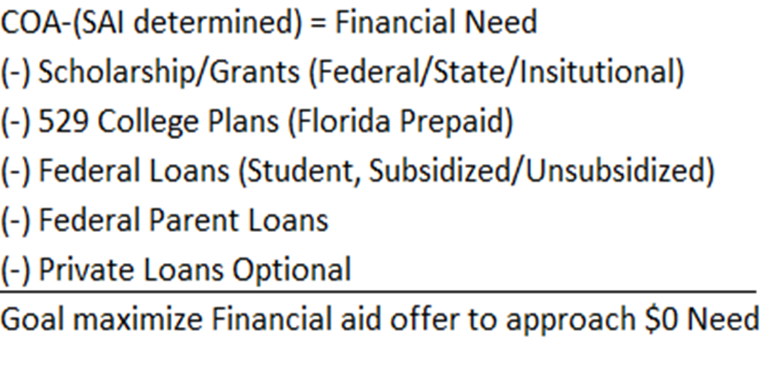
FAFSA Additional Information
Verification Process
Communication with Postsecondary Institutions
Offer of Financial Aid:

Slide 19
Florida Financial Aid Application
The Florida Financial Aid Application (FFAA) opens October 1
Apply Early – must be completed prior to August 31 of high school graduation year
One application is used for multiple programs, not just the Florida Bright Futures Scholarship Program
Students may login to view status, online notifications, and award history
Apply at www.FloridaStudentFinancialAidsg.org

Slide 20
Florida Financial Aid Application

Slide 21
Florida Financial Aid Application
State Scholarship and Grant Programs requiring a timely completed Florida Financial Aid Application:
Florida Bright Futures Scholarship Program
Scholarship for Children and Spouses of Deceased or Disabled Veterans
José Martí Challenge Grant
Rosewood Family Scholarship
Florida Farmworker Student Scholarship
Randolph Bracy Ocoee Scholarship

Slide 22
State Scholarship and Grants
Need-Based Programs:
Florida Student Assistance Grant (FSAG)
Florida Work Experience Program (FWEP)
Tuition Assistance Program
William L. Boyd, IV, Effective Access to Student Education Grant Program (EASE)

Slide 23
State Scholarship and Grants
Merit-Based Programs:
Florida Bright Futures Scholarship Program
Benacquisto Scholarship Program

Slide 24
State Scholarship and Grants
Other Programs:
First Generation Matching Grant (FGMG)
Florida Farmworker Student Scholarship (FFSS)
José Martí Scholarship Challenge Grant (JM)
Mary McLeod Bethune Scholarship (MMB)
Minority Teacher Education Scholarship (MTES)
Rosewood Family Scholarship (RFS)
Scholarships for Children and Spouses of Deceased or Disabled Veterans (CSDDV)
Randolph Bracy Ocoee Scholarship (OCOE)
Florida First Responder Scholarship Program (FFRSP)
Open Door Grant Program (ODGP)

Slide 25
State Scholarship and Grants
Florida Bright Futures Scholarship Program for home education program students:
Meet the General Requirements for a Bright Futures Award;
Submit a timely FFAA;
Earn required minimum test scores; and
Complete the minimum number of volunteer service hours, paid work hours, or combination of 100 total hours.

Slide 26
Private Scholarships
Search Criteria:
Targeted Searches
Schools (high school/postsecondary institution)
Private Scholarship list website (traditionally requires separate application)
Scholarships at specific college
Place of employment (students/parents)
National websites

Slide 27
Review Action Items:
Federal – Financial Aid (FAFSA)
Monitor application opening date: October 1, 2024
Create an FSA ID and password NOW
State – Financial Aid (FFAA)
Monitor application opening date: October 1, 2024
Ensure meeting requirements
General Requirements
Scholarship Program Requirements
Private Scholarships – apply, apply, apply
CSS Profile – If institution requires
Additional required institutional applications

Slide 28
Additional Information
Office of Student Financial Assistance State Scholarship and Grant Programs
Website: www.FloridaStudentFinancialAidsg.org
www.navigatingyourfinancialfuture.org
Email: Pedro.Hernandez@fldoe.org
Telephone: (850) 245-1821

